Slide 1

Meet Your Instructor

Slide 2
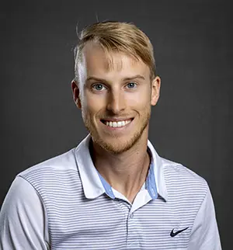
Introductions
Hello! My name is Colton Gearhart!
I am not too formal, so feel free to just call me Colton.
I am from the Northern Kentucky area and have lived here my most of my life.

Slide 3
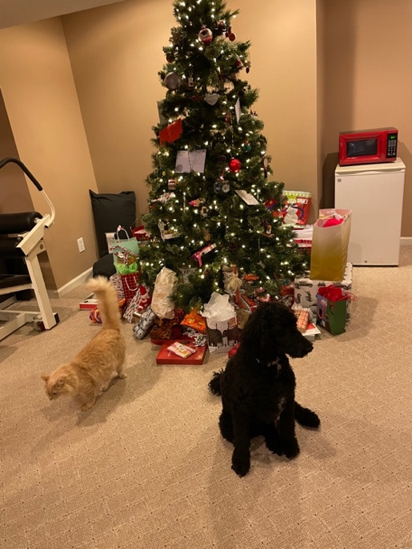
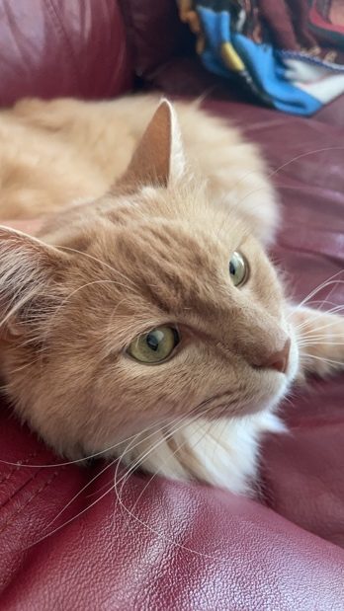
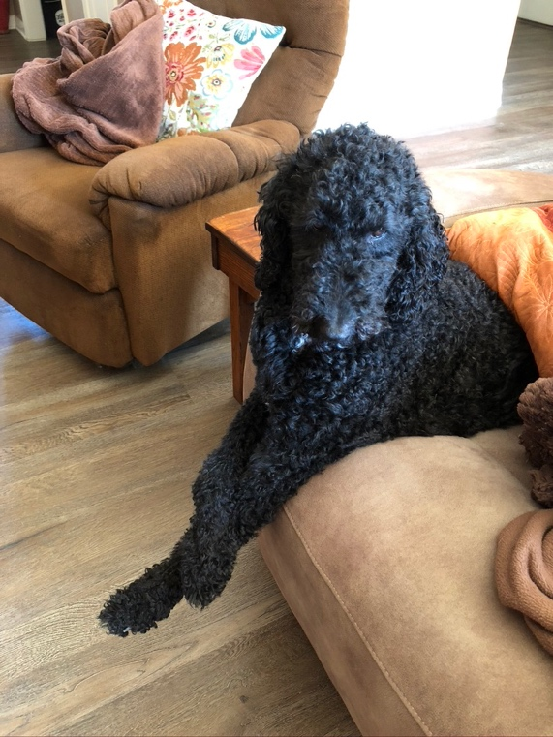
More about me!
I have two pets: coolest cat ever named Kix and a princess standard poodle named Kizzy!
I miss them everyday when I am here ☹

Slide 4
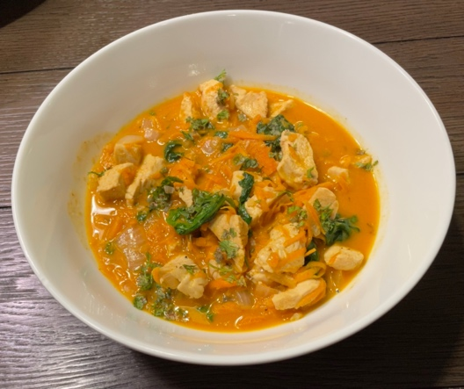
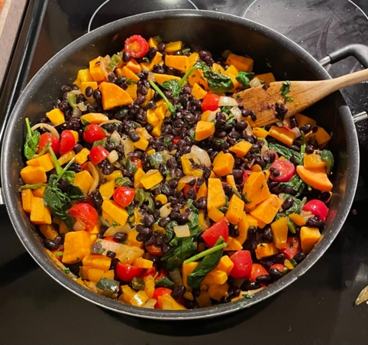

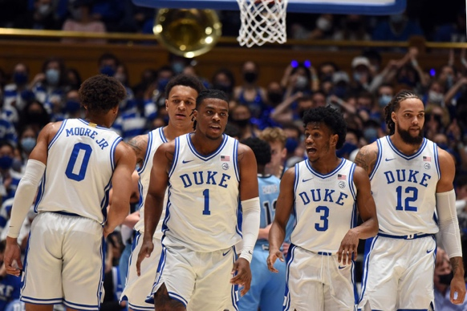
More about me!
Outside of the classroom, my interests include cooking, sports and travelling!
I am a huge Liverpool fan, which is a soccer team that plays in England. Also, my family are diehard Duke basketball supporters!

Slide 5
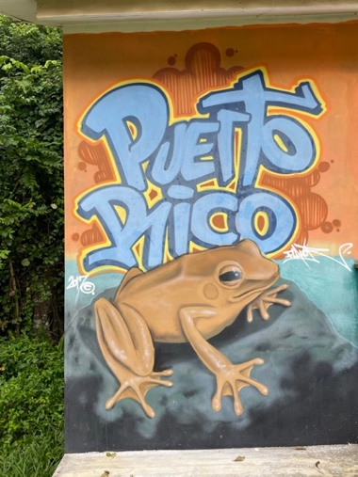
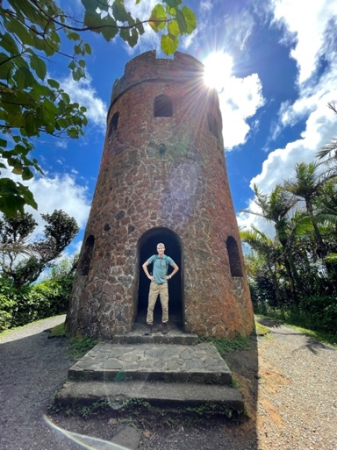
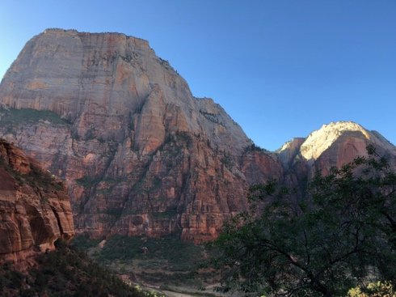
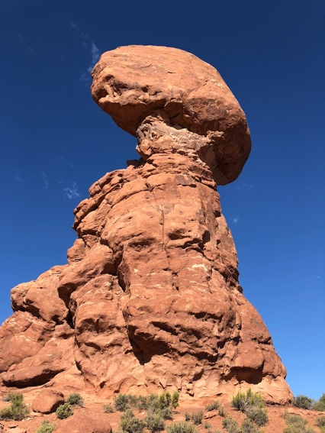
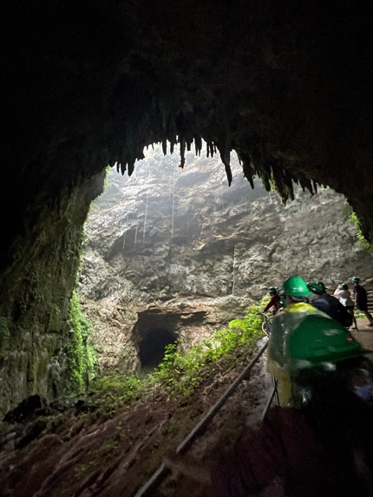
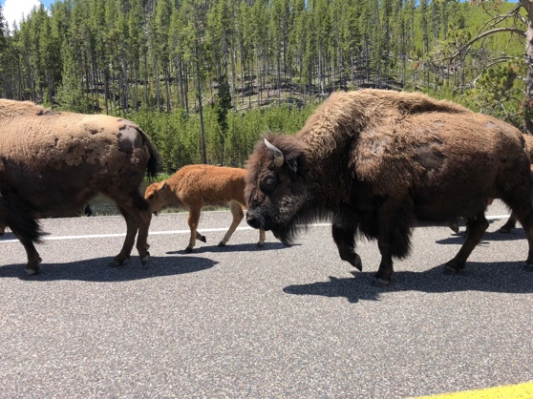
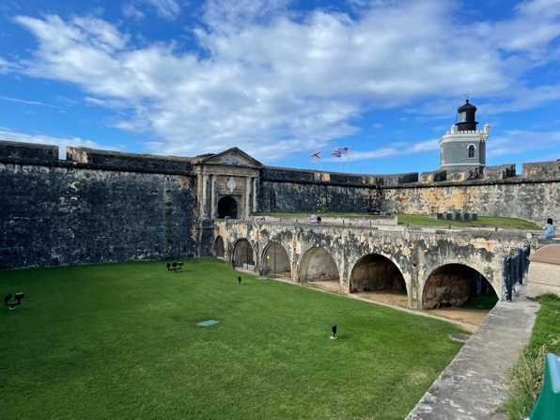
Travels!
I have been to national parks all around the country,
Puerto Rico, and most recently Italy and Switzerland!

Slide 6
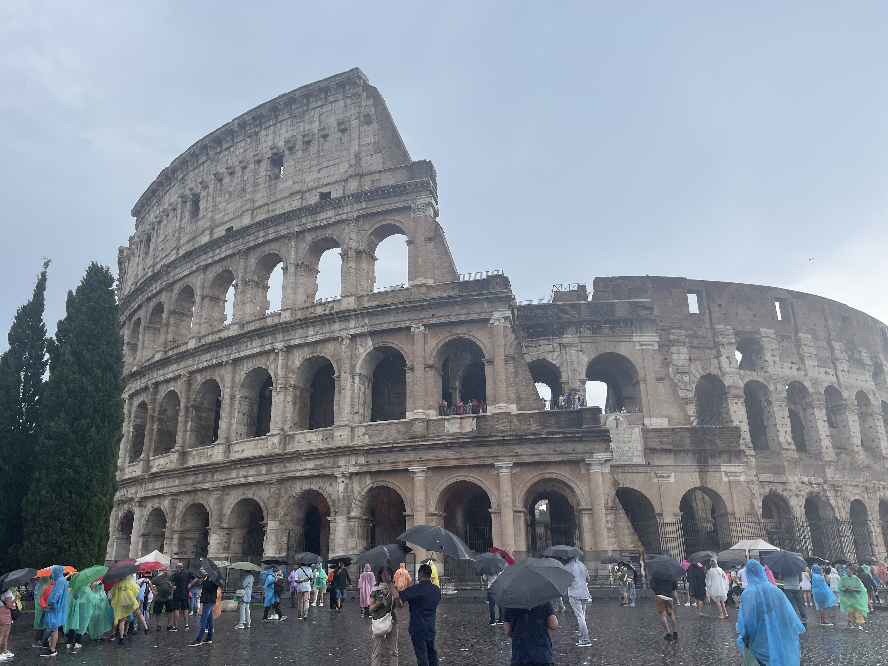

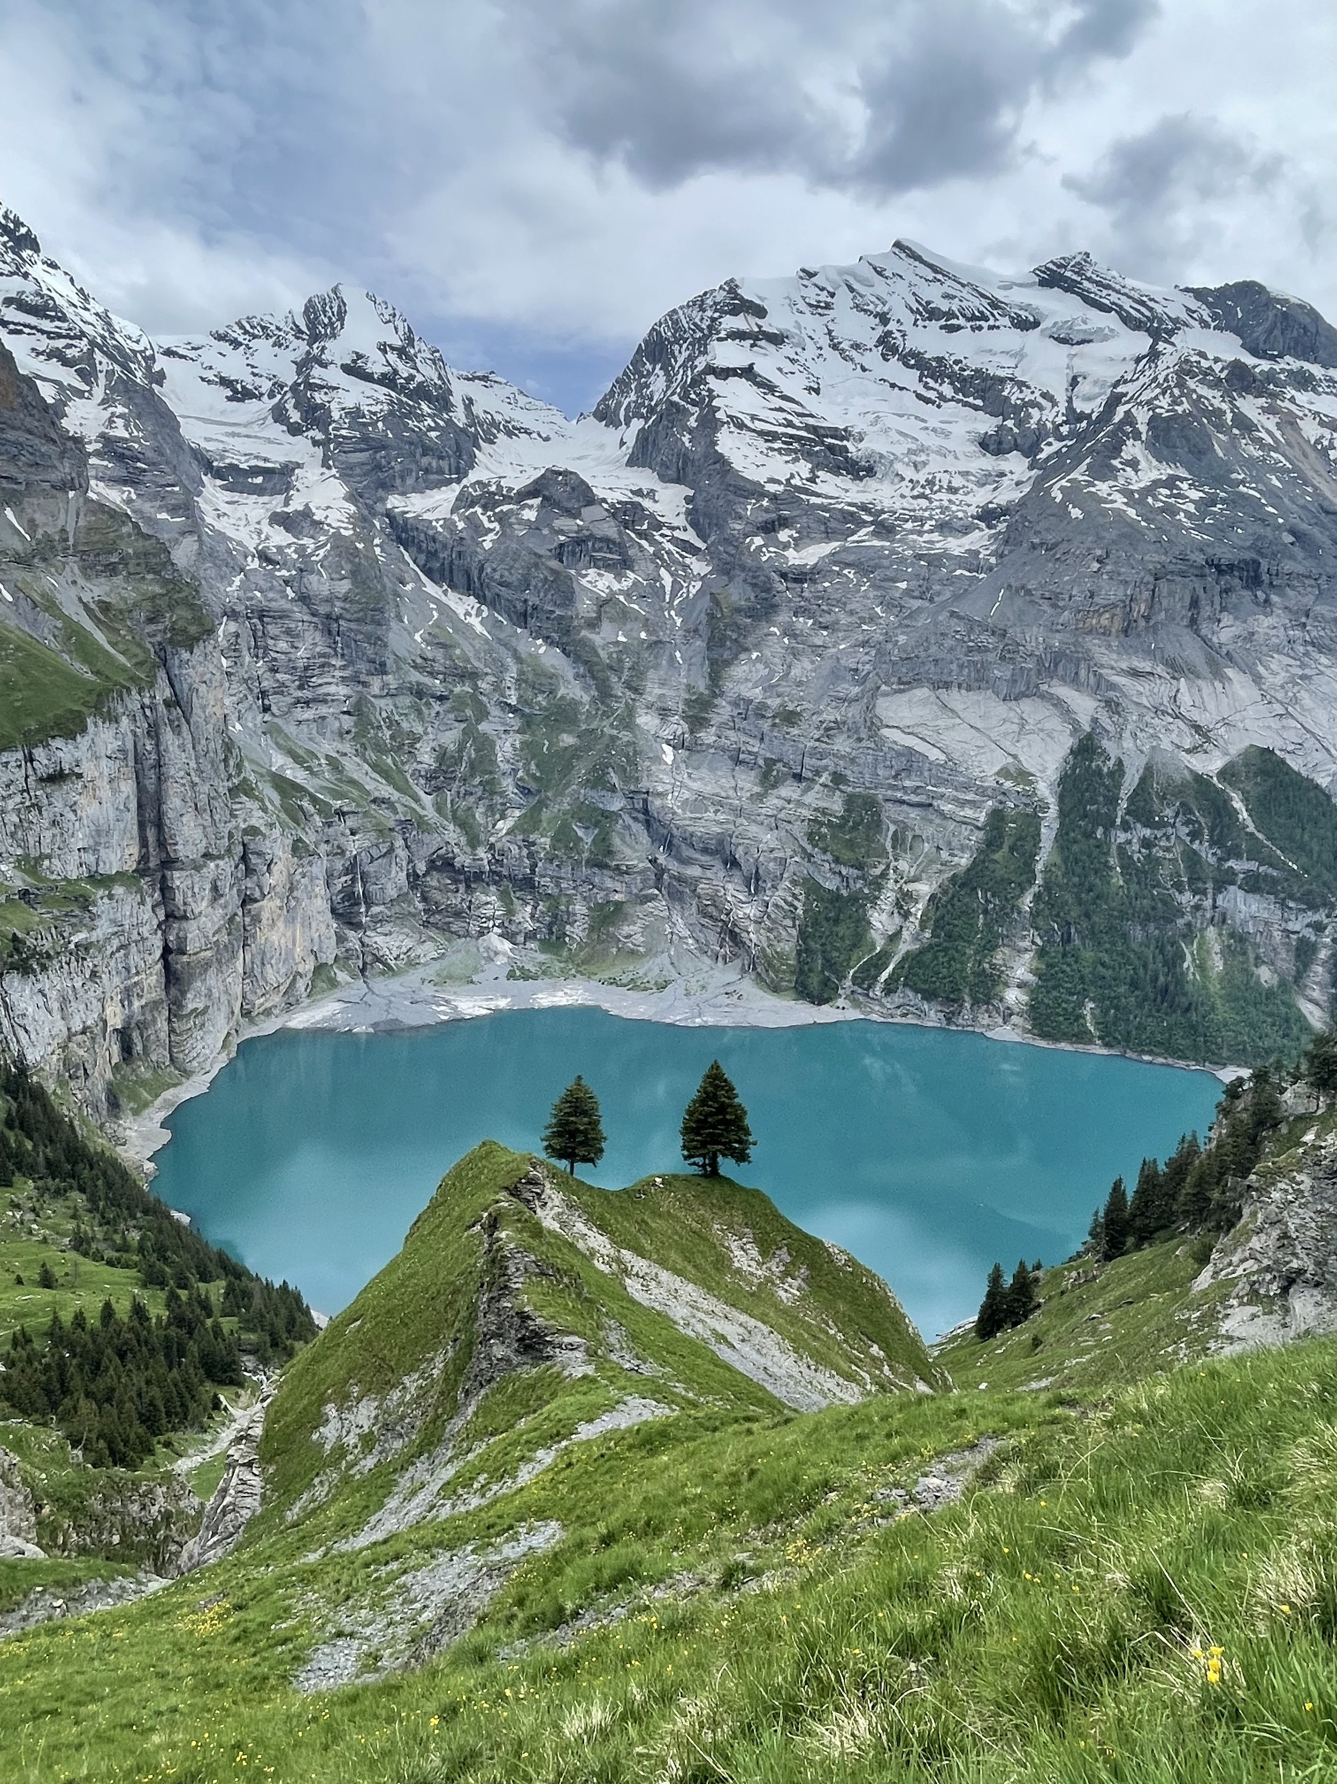
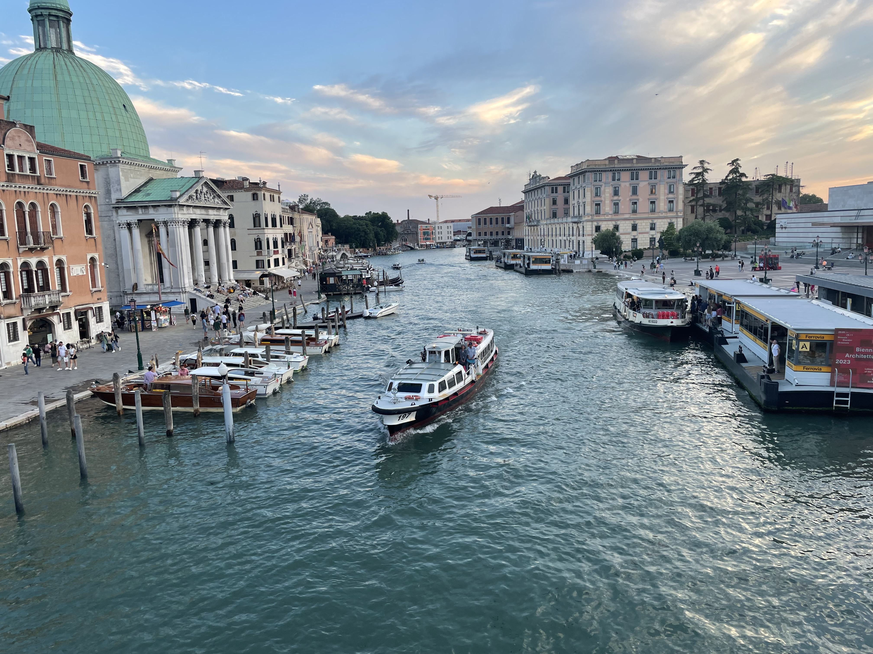
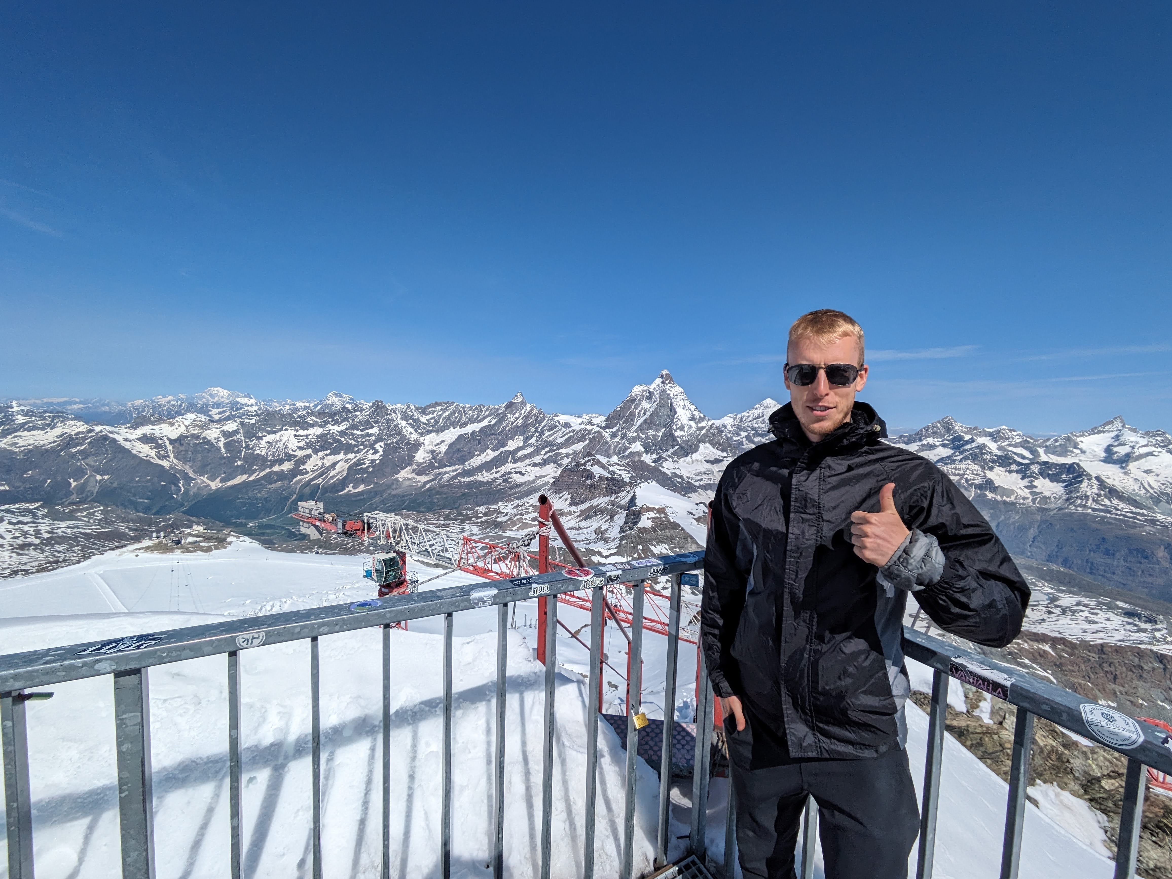
IMG_7016.HEIC
IMG_6681.HEIC
PXL_20230617_082142832_Original.jpg
IMG_6378.HEIC
IMG_6262.HEIC

Slide 7



Background
Education
Graduated from Northern Kentucky University in 2018 with a BS in Mathematics and Statistics
Graduated from Miami University in 2020 with an MS in Statistics
Professional
Graduate assistant – Helped teach introductory statistics classes while at Miami
Professor
Cincinnati State and Columbus State – Taught intro courses for spring and summer semesters of 2021
Ball State University – Started in FA 2021 where I teach MATH 125, 320 (Probability), 321 (Statistics), and DANA 320 (Data Visualization)

Slide 8
Teaching Philosophy
Class Goals
Foster a classroom environment that encourages you to take an active part in your learning.
Students to feel comfortable sharing your ideas, questions, comments and concerns with me and your classmates.
How
More “conversational” lessons rather than just lectures.
Structure lessons and present material so that you are engaged as much as possible.
Lots of participation opportunities.
Why
For starters, class is wayyy more fun when everyone is involved! Learning is awesome and its more fun together!
Strongly believe that community is an important part of learning.
The more students engage (participating in lectures, actively solving problems, asking questions), the more success they will have (in any class). It’s a simple equation!
Challenge to You
I hope we can work together to achieve these goals, and if so I guarantee class will be better and more rewarding because of it!

Slide 9

In Closing
I think that covers the basics! We are going to learn a lot this semester and have some fun along the way!
I look forward to being able to get to know each of you as our semester moves on.

